Slide 1
Chapter 5

Slide 2
Chapter 5: The Data Link Layer
Our goals:
understand principles behind data link layer services:
error detection, correction
sharing a broadcast channel: multiple access
link layer addressing
reliable data transfer, flow control: done!
instantiation and implementation of various link layer technologies

Slide 3
Outline
5.1 Introduction and services
5.2 Error detection & correction
5.4 Link-layer Addressing & ARP
5.3 Multiple access protocols
5.5 Ethernet
6.3 IEEE 802.11 wireless LANs (“Wi-Fi”)
Not covered
5.6 Link-layer switches
5.7 PPP
5.8 Link virtualization: MPLS

Slide 4

Link Layer: Introduction
Terminology:
hosts and routers are nodes
communication channels that connect adjacent nodes along communication path are links
wired links
wireless links
LANs
layer-2 packet is a frame, encapsulates datagram
data-link layer has responsibility of
transferring datagram from one node
to physically adjacent node over a link

Slide 5
What Is Data Link
Communication channels that connect adjacent nodes along communication path are links
By adjacent, we mean that the two machines are connected by a communication channel that acts conceptually like a wire.
Data-link layer deals with algorithms for achieving reliable, efficient communication of whole units of information called frames between two adjacent machines.

Slide 6
Properties and Limitations for a link
Essential Property
The bits are delivered in exactly the same order in which they are sent.
Limitations
Communication circuits make errors occasionally
They have only a finite data rate, and
There is a nonzero propagation delay between the time bit sent and the time it is received

Slide 7
DLL Design Issues
Functions of the Data Link Layer
Providing a well-defined service interface to the network layer
Dealing with transmission errors
Regulating data flow
Slow receivers not swamped by fast senders

Slide 8
Link Layer Services
11111101110101110111010101
framing, link access:
encapsulate datagram into frame, adding header, trailer
channel access if shared medium
“MAC” addresses used in frame headers to identify source, dest
different from IP address!
reliable delivery between adjacent nodes
we learned how to do this already (chapter 3)!
seldom used on low bit-error link (fiber, some twisted pair)
wireless links: high error rates
Q: why both link-level and end-end reliability?

Slide 9
Link Layer Services (more)
flow control:
pacing between adjacent sending and receiving nodes
error detection:
errors caused by signal attenuation, noise.
receiver detects presence of errors:
signals sender for retransmission or drops frame
error correction:
receiver identifies and corrects bit error(s) without resorting to retransmission
half-duplex and full-duplex
with half duplex, nodes at both ends of link can transmit, but not at same time

Slide 10
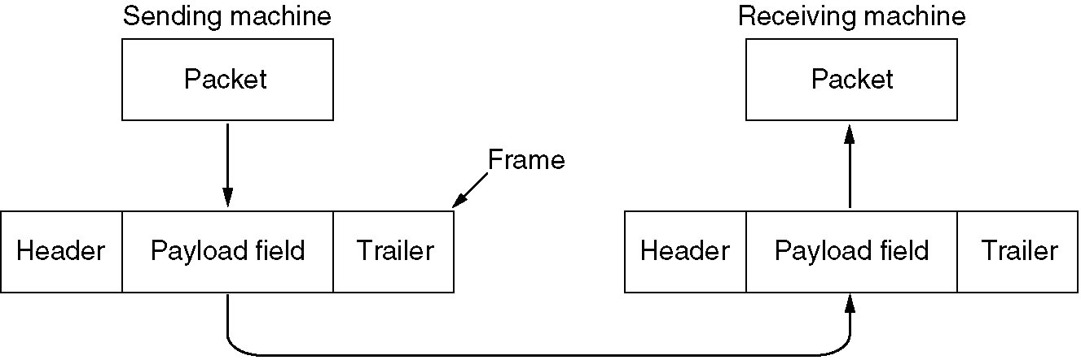
Frame
DLL takes the packets it gets from the network layer and encapsulates them into frames for transmission
Relationship between packets and frames

Slide 11
Framing
The DLL translates the physical layer's raw bit stream into discrete units (messages) called frames. How can frame be transmitted so the receiver can detect frame boundaries? That is, how can the receiver recognize the start and end of a frame? We will discuss four ways:
• Byte Count
• Flag bytes with byte stuffing
• Flag bits with bit stuffing
• Physical layer coding Violations

Slide 12
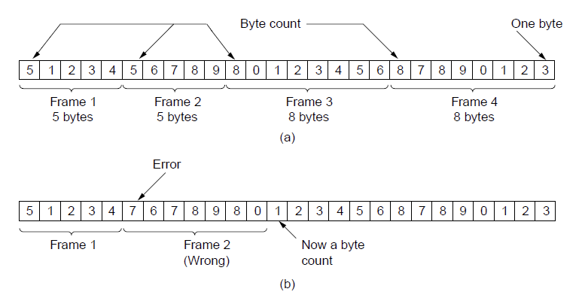
Byte Count
A byte stream. (a) Without errors. (b) With one error.

Slide 13
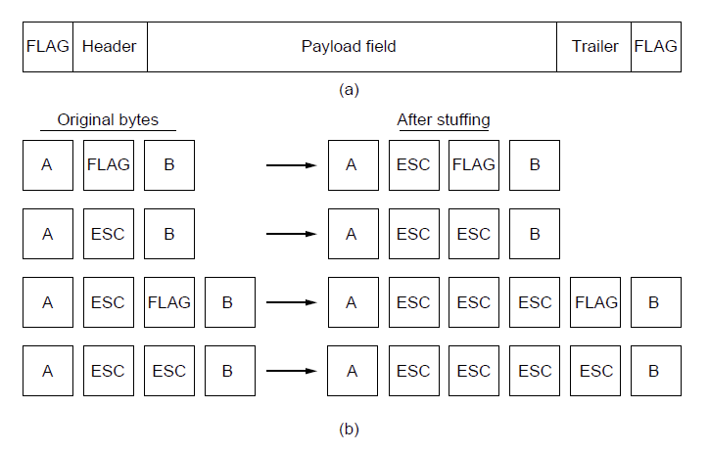
Flag bytes with byte stuffing
(a) A frame delimited by flag bytes.
(b) Four examples of byte sequences before and after stuffing.

Slide 14
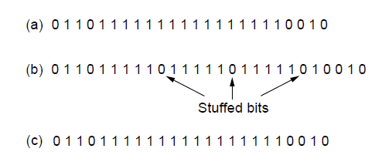
Flag bits with bit stuffing
01111110
011111010
Bit stuffing bits pattern : 01111110
(a) The original data.
(b) The data as they appear on the line.
(c)The data as they are stored in the receiver’s memory after destuffing.

Slide 15
Physical layer coding violations
Send a signal that doesn't conform to any legal bit representation. For example, in the 4B/5B line code 4 data its are mapped to 5 signal bits to ensure sufficient bit transitions. This means that 16 out of 32 signal possibilities are not used. We can use some reserved signals to indicate the start and end of frames.
The advantage of encoding violations is that it is easy to find the start and end of frames and there is no need to stuff the data.

Slide 16
Combination of framing methods
Many data link protocols use a combination of these methods for safety. A common pattern used for Ethernet and 802.11 is to have a frame begin with a well-defined pattern called a preamble. The preamble is then followed by a length (i.e. count) field in the header that is used to locate the end of the frame.

Slide 17
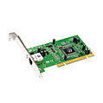
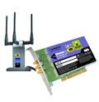
Where is the link layer implemented?
in each and every host
link layer implemented in “adaptor” (aka network interface card NIC)
Ethernet card, PCMCI card, 802.11 card
implements link, physical layer
attaches into host’s system buses
combination of hardware, software, firmware
host schematic
application
transport
network
link
cpu
memory
link
physical
host
bus
(e.g., PCI)
controller
physical
transmission
network adapter
card

Slide 18
Adaptors Communicating
datagram
datagram
controller
controller
sending host
receiving host
datagram
frame
sending side:
encapsulates datagram in frame
adds error checking bits, rdt, flow control, etc.
receiving side
looks for errors, rdt, flow control, etc
extracts datagram, passes to upper layer at receiving side

Slide 19
Outline
5.1 Introduction and services
5.2 Error detection & correction
5.4 Link-layer Addressing & ARP
5.3 Multiple access protocols
5.5 Ethernet
6.3 IEEE 802.11 wireless LANs (“Wi-Fi”)
Not covered
5.6 Link-layer switches
5.7 PPP
5.8 Link virtualization: MPLS

Slide 20
Error Correcting/Detecting Codes
Detecting and correcting errors requires redundancy - sending additional information along with the data.
Two basic strategies:
Error Correcting Codes: Include enough redundancy to detect and correct errors. (FEC, Forward Error Correction)
Error Detecting Codes : Include enough redundancy bits to detect errors and use ACKs and retransmissions to recover from the errors.

Slide 21
Modeling errors
One model is that errors are caused by extreme values of thermal noise that overwhelm the signal briefly and occasionally, giving rise to isolated single-bit errors.
Another model is that errors tend to come in bursts rather than singly. This model follows from the physical processes that generate them
– such as a deep fade on a wireless channel.
Both models matter in practice, and they have different trade-offs.

Slide 22
Error-Correcting Codes
1. Hamming codes.
2. Binary convolutional codes.
3. Reed-Solomon codes.
4. Low-Density Parity Check codes.
Codeword (n,m): n bits=m bits data + r bits redundant
Code rate: m/n

Slide 23
Hamming Distance
Given any two codewords, we can determine how many of the bits differ by Exclusive OR (XOR) of the two words. The number of 1 bits in the result is the Hamming Distance.
If two codewords are d bits apart, d errors are required to convert one to the other.
10001001
10110001
---------------------
00111000

Slide 24
Hamming Distance
In general, all 2^{m} possible data words are legal. However, by choosing check bits carefully, the resulting codeword will have a large Hamming Distance. The larger the Hamming distance, the better the codes are able to detect errors.
To detect d 1-bit errors requires having a Hamming Distance of at least d + 1 bits.
To correct d errors requires distance of 2d + 1 bits. Intuitively, after d errors, the garbled messages is still closer to the original message than any other legal codeword..

Slide 25
Hamming Distance
2^r > m + r + 1 where, r = redundant bit, m = data bit

Slide 26
Hamming Distance
General Algorithm of Hamming code – The Hamming Code is simply the use of extra parity bits to allow the identification of an error.
Write the bit positions starting from 1 in binary form (1, 10, 11, 100, etc).
All the bit positions that are a power of 2 are marked as parity bits (1, 2, 4, 8, etc).
All the other bit positions are marked as data bits.
Each data bit is included in a unique set of parity bits, as determined its bit position in binary form. a. Parity bit 1 covers all the bits positions whose binary representation includes a 1 in the least significant position (1, 3, 5, 7, 9, 11, etc). b. Parity bit 2 covers all the bits positions whose binary representation includes a 1 in the second position from the least significant bit (2, 3, 6, 7, 10, 11, etc).

Slide 27
Correcting errors (Ex)
As an example, consider a 10-bit code used to represent 4 possible values:
"00000 00000", "00000 11111", "11111 00000", and "11111 11111".
Its Hamming distance is 5, and we can correct 2 single-bit errors.
Example: "10111 00010" becomes "11111 00000" by changing only two bits.
However, if the sender transmits "11111 00000" and the receiver sees "00011 00000", the receiver will not correct the error properly.
Finally, in this example we are guaranteed to catch all 2-bit errors, but we might do better: if "00111 00111" contains 4 single-bit errors, we will reconstruct the block correctly.

Slide 28

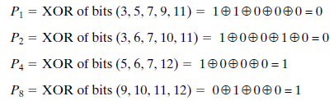

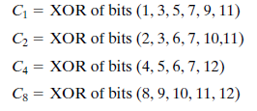
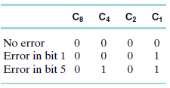
Hamming code
Data bits 11000100 (positions not powers of 2)
Calculating parity
Sending end
Receiving end
Decision

Slide 29
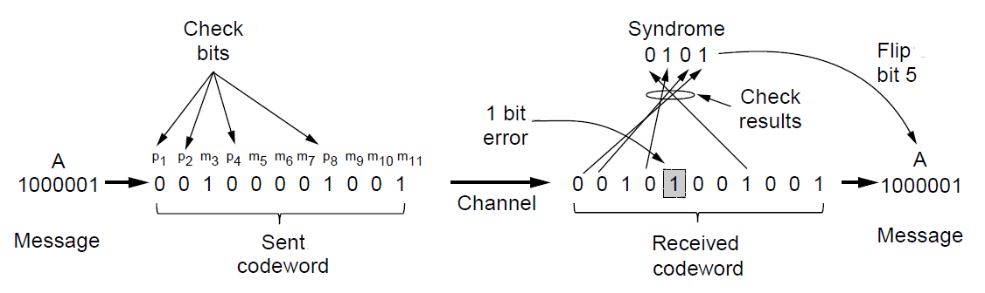
Hamming code
the check bits are computed for even parity sums
k = 8, 4, 2, and 1
This gives a syndrome of 0101 or 4 + 1=5.
Example of an (11, 7) Hamming code correcting a single-bit error.

Slide 30
Convolutional Code (cont.)
Hamming codes are used in error-correcting memory
However, most networks use stronger codes. The second code we will look at is a convolutional code.
In a convolutional code, an encoder processes a sequence of input bits and generates a sequence of output bits.
There is no natural message size or encoding boundary
The output depends on the current and previous input bits.
The number of previous bits on which the output depends is called the constraint length of the code.

Slide 31
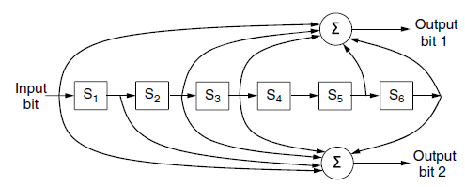
Convolutional Code (cont.)
Convolutional codes are widely used in deployed networks, for example, as part of the GSM mobile phone system, in satellite communications, and in 802.11.
The NASA binary convolutional code used in 802.11.
r = 1/2 and k = 7 (6 registers)
Since 1 input bit produces 2 output bits, the code rate is 1/2.

Slide 32
Convolutional Code (cont.)
A convolutional code is decoded by finding the sequence of input bits that is most likely to have produced the observed sequence of output bits (which includes any errors).

Slide 33
Reed-Solomon code
The third kind of error-correcting code we will describe is the Reed-Solomon code. Like Hamming codes, Reed-Solomon codes are linear block codes, and they are often systematic too. Unlike Hamming codes, which operate on individual bits, Reed-Solomon codes operate on m bit symbols.
Reed-Solomon codes are actually defined as polynomials that operate over finite fields, but they work in a similar manner.
Reed-Solomon codes are widely used in practice e.g., DSL, data over cable, satellite communications, and perhaps most ubiquitously on CDs, DVDs, and Blu-ray discs.

Slide 34
LDPC (Low-Density Parity Check)
In an LDPC code, each output bit is formed from only a fraction of the input bits.
This leads to a matrix representation of the code that has a low density of 1s, hence the name for the code.
The received codewords are decoded with an approximation algorithm that iteratively improves on a best fit of the received data to a legal codeword. This corrects errors.
Used as standard for digital video broadcasting, 10 Gbps Ethernet, power-line networks, and the latest version of 802.11.

Slide 35
Error-Detecting Codes
Linear, systematic block codes
1. Parity
2. Checksums
3. Cyclic Redundancy Checks (CRCs)

Slide 36
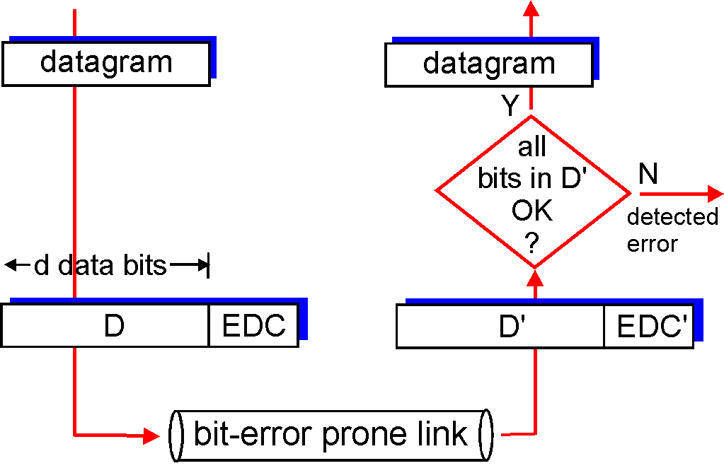
Error Detection
EDC= Error Detection and Correction bits (redundancy)
D = Data protected by error checking, may include header fields
Error detection is not 100% reliable!
protocol may miss some errors, but rarely
larger EDC field yields better detection and correction
otherwise

Slide 37
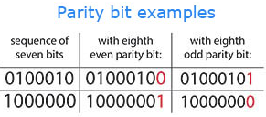
Parity Bits
A single parity bit is appended to each data block (e.g. each character in ASCII systems) so that the number of 1 bits always adds up to an even (odd) number.
1000000(1) 1111101(0)
The Hamming Distance for parity is 2, and it cannot correct even single-bit errors (but can detect single-bit errors).

Slide 38
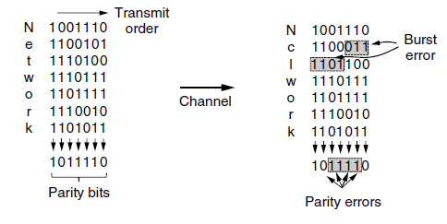
Interleaving of parity bits to detect a burst error.

Slide 39
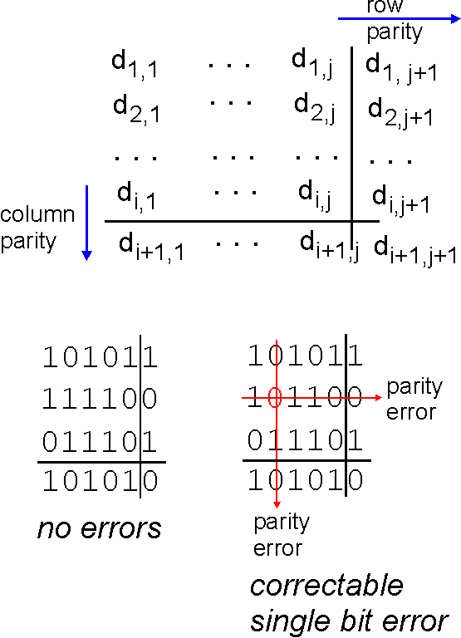
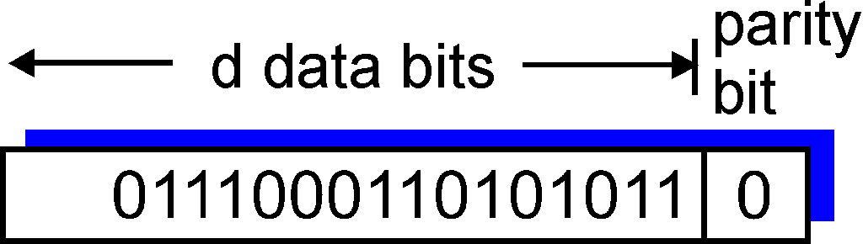
Two Dimensional Parity Bit
Single Bit Parity:
Detect single bit errors
Two Dimensional Bit Parity:
Detect and correct single bit errors
0
0

Slide 40
Checksum
Checksum means a group of check bits associated with a message, regardless of how they are calculated.
The checksum is usually placed at the end of the message, as the complement of the sum function. So errors may be detected by summing the entire received codeword, both data and checksum. If the result comes out to be zero, no error has been detected.
16bit Internet checksum

Slide 41
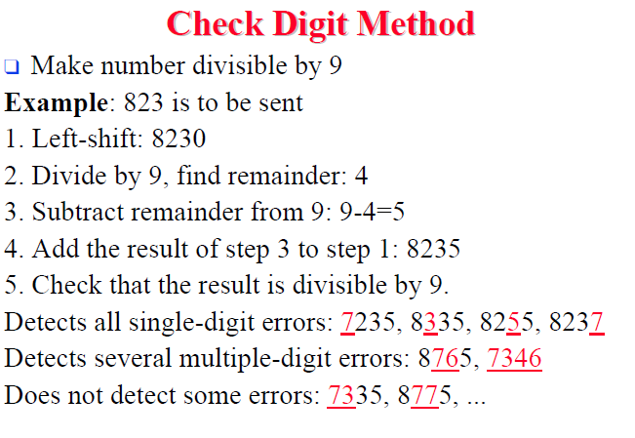

Slide 42
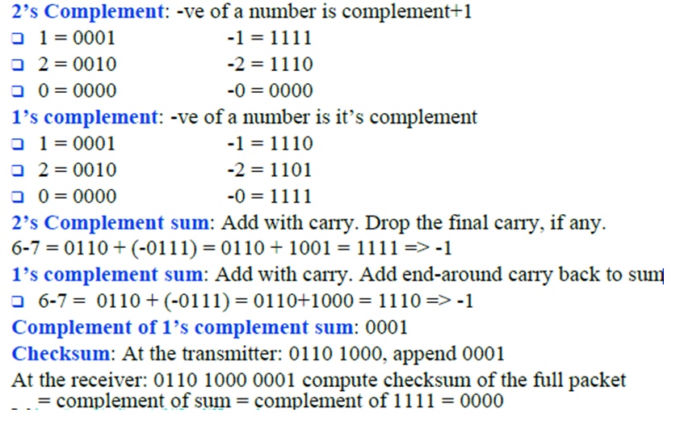
1’s Complemnt

Slide 43
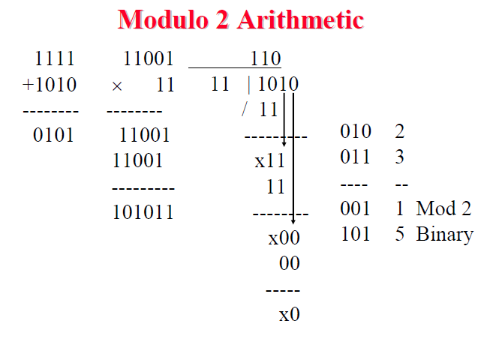

Slide 44
Cyclic Redundancy Check
The most popular error detection code at the link layer is based on polynomial code, also known as Cyclic Redundancy Check .
Allows us to acknowledge correctly received frames and to discard incorrect ones.

Slide 45
Cyclic Redundancy Check (CRC)
Binary Check Digit Method
Make number divisible by P=110101 (n+1=6 bits)
Example: M=1010001101 is to be sent
Left-shift M by n bits 2^{n}M= 101000110100000
Divide 2^{n}M by P, find remainder: R=01110
Subtract remainder from P ← Not required in Mod 2
Add the result of step 2 to step 1 :
T=101000110101110
Check that the result T is divisible by P.

Slide 46
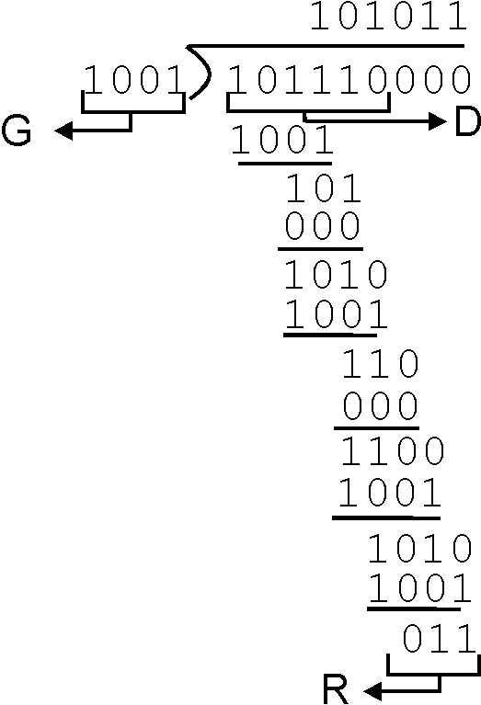
CRC Example
Want:
D.2^{r} XOR R = nG
equivalently:
D.2^{r} = nG XOR R
equivalently:
if we divide D.2^{r} by G, want remainder R
D.2^{r}
G
R = remainder[ ]

Slide 47
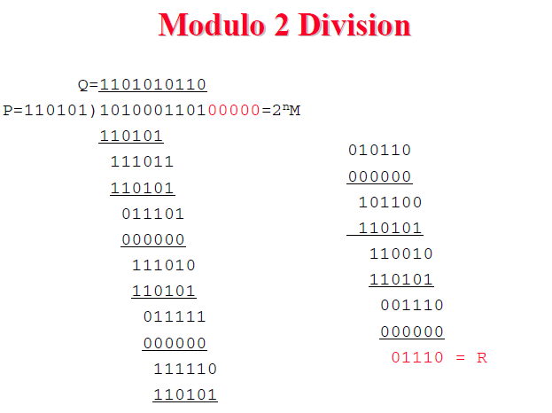

Slide 48
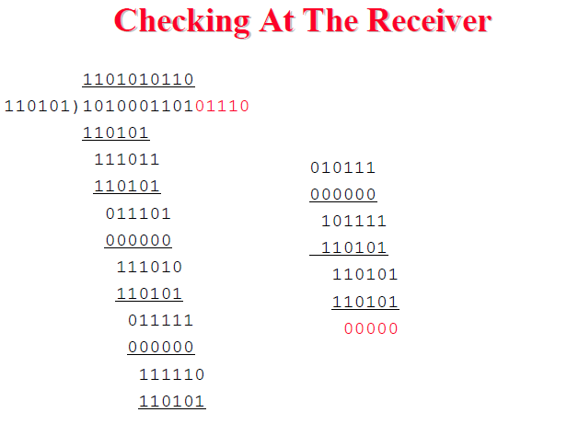

Slide 49
Outline
5.1 Introduction and services
5.2 Error detection & correction
5.4 Link-layer Addressing & ARP
5.3 Multiple access protocols
5.5 Ethernet
6.3 IEEE 802.11 wireless LANs (“Wi-Fi”)
Not covered
5.6 Link-layer switches
5.7 PPP
5.8 Link virtualization: MPLS

Slide 50
MAC Addresses and ARP
32-bit IP address:
network-layer address for interface
used for layer 3 (network layer) forwarding
MAC (or LAN or physical or Ethernet) address:
function: used ‘locally” to get frame from one interface to another physically-connected interface (same network, in IP-addressing sense)
48 bit MAC address (for most LANs) burned in NIC ROM, also sometimes software settable
e.g.: 1A-2F-BB-76-09-AD
hexadecimal (base 16) notation
(each “number” represents 4 bits)

Slide 51
LAN Addresses and ARP
Each adapter on LAN has unique LAN address
1A-2F-BB-76-09-AD
Broadcast address =
FF-FF-FF-FF-FF-FF
LAN
(wired or
wireless)
= adapter
71-65-F7-2B-08-53
58-23-D7-FA-20-B0
0C-C4-11-6F-E3-98
Quick review of special IP addresses
Loopback: 127.0.0.1
Local broadcast: 255.255.255.255

Slide 52
LAN Address (more)
MAC address allocation administered by IEEE
manufacturer buys portion of MAC address space (to assure uniqueness)
analogy:
(a) MAC address: like Social Security Number
(b) IP address: like postal address
MAC flat address ➜ portability
can move LAN card from one LAN to another
IP hierarchical address NOT portable
address depends on IP subnet to which node is attached

Slide 53
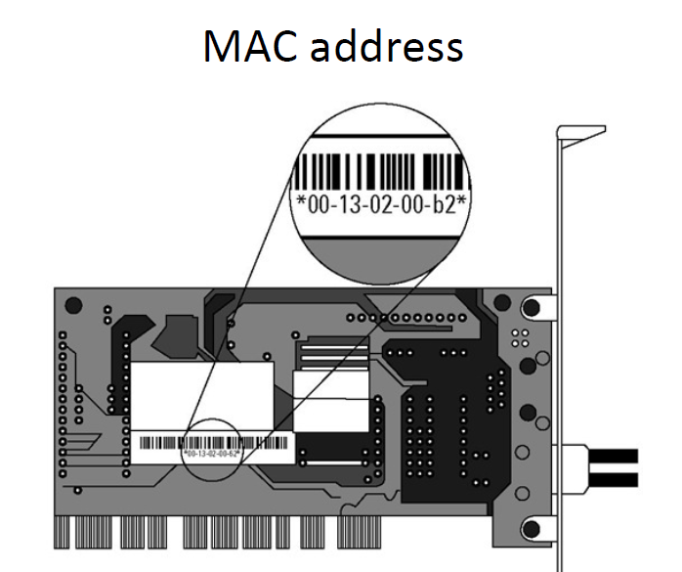

Slide 54
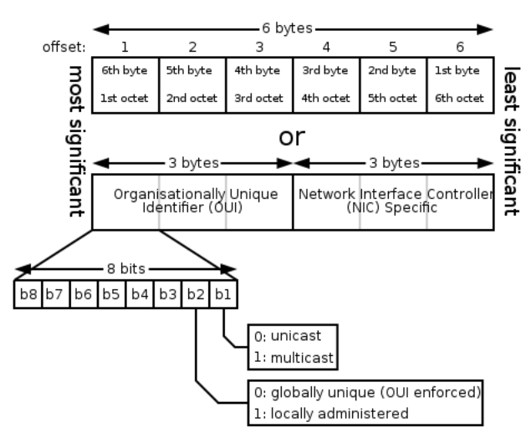
MAC address (details)
Addresses can either be universally administered addresses or locally administered addresses. A universally administered address is uniquely assigned to a device by its manufacturer; these are sometimes called burned-in addresses.
A locally administered address is assigned to a device by a network administrator, overriding the burned-in address. Locally administered addresses do not contain OUIs.

Slide 55
ARP: Address Resolution Protocol
Question: how to determine
MAC address of B
knowing B’s IP address?
Each IP node (host, router) on LAN has ARP table
ARP table: IP/MAC address mappings for some LAN nodes
< IP address; MAC address; TTL>
TTL (Time To Live): time after which address mapping will be forgotten (typically 20 min)
137.196.7.78
1A-2F-BB-76-09-AD
137.196.7.23
137.196.7.14
LAN
71-65-F7-2B-08-53
58-23-D7-FA-20-B0
0C-C4-11-6F-E3-98
137.196.7.88
Try:
ARP - a

Slide 56
ARP protocol: same LAN (network)
A wants to send datagram to B, and B’s MAC address not in A’s ARP table.
A broadcasts ARP query packet, containing B's IP address
dest MAC address = FF-FF-FF-FF-FF-FF
all machines on LAN receive ARP query
B receives ARP packet, replies to A with its (B's) MAC address
frame sent to A’s MAC address (unicast)
A caches (saves) IP-to-MAC address pair in its ARP table until information becomes old (times out)
soft state: information that times out (goes away) unless refreshed
ARP is “plug-and-play”:
nodes create their ARP tables without intervention from net administrator

Slide 57
Addressing: routing to another LAN
walkthrough: send datagram from A to B via R.
focus on addressing - at both IP (datagram) and MAC layer (frame)
assume A knows B’s IP address
assume A knows IP address of first hop router, R (how?)
assume A knows MAC address of first hop router interface (how?)
A
B
R
111.111.111.111
222.222.222.222
74-29-9C-E8-FF-55
49-BD-D2-C7-56-2A
222.222.222.220
1A-23-F9-CD-06-9B
111.111.111.112
111.111.111.110
222.222.222.221
CC-49-DE-D0-AB-7D
E6-E9-00-17-BB-4B
88-B2-2F-54-1A-0F

Slide 58
Addressing: routing to another LAN
A creates IP datagram with IP source A, destination B
A creates link-layer frame with R's MAC address as dest, frame contains A-to-B IP datagram
MAC src: 74-29-9C-E8-FF-55
MAC dest: E6-E9-00-17-BB-4B
IP
Eth
Phy
IP src: 111.111.111.111
IP dest: 222.222.222.222
A
B
R
111.111.111.111
222.222.222.222
74-29-9C-E8-FF-55
49-BD-D2-C7-56-2A
222.222.222.220
1A-23-F9-CD-06-9B
111.111.111.112
111.111.111.110
222.222.222.221
CC-49-DE-D0-AB-7D
E6-E9-00-17-BB-4B
88-B2-2F-54-1A-0F

Slide 59
Addressing: routing to another LAN
frame sent from A to R
frame received at R, datagram removed, passed up to IP
MAC src: 74-29-9C-E8-FF-55
MAC dest: E6-E9-00-17-BB-4B
IP
Eth
Phy
IP src: 111.111.111.111
IP dest: 222.222.222.222
IP
Eth
Phy
A
B
R
111.111.111.111
222.222.222.222
74-29-9C-E8-FF-55
49-BD-D2-C7-56-2A
222.222.222.220
1A-23-F9-CD-06-9B
111.111.111.112
111.111.111.110
222.222.222.221
CC-49-DE-D0-AB-7D
E6-E9-00-17-BB-4B
88-B2-2F-54-1A-0F

Slide 60
Addressing: routing to another LAN
R forwards datagram with IP source A, destination B
R creates link-layer frame with B's MAC address as dest, frame contains A-to-B IP datagram
MAC src: 1A-23-F9-CD-06-9B
MAC dest: 49-BD-D2-C7-56-2A
IP
Eth
Phy
IP
Eth
Phy
IP src: 111.111.111.111
IP dest: 222.222.222.222
A
B
R
111.111.111.111
222.222.222.222
74-29-9C-E8-FF-55
49-BD-D2-C7-56-2A
222.222.222.220
1A-23-F9-CD-06-9B
111.111.111.112
111.111.111.110
222.222.222.221
CC-49-DE-D0-AB-7D
E6-E9-00-17-BB-4B
88-B2-2F-54-1A-0F

Slide 61
Addressing: routing to another LAN
R forwards datagram with IP source A, destination B
R creates link-layer frame with B's MAC address as dest, frame contains A-to-B IP datagram
MAC src: 1A-23-F9-CD-06-9B
MAC dest: 49-BD-D2-C7-56-2A
IP
Eth
Phy
IP
Eth
Phy
IP src: 111.111.111.111
IP dest: 222.222.222.222
A
B
R
111.111.111.111
222.222.222.222
74-29-9C-E8-FF-55
49-BD-D2-C7-56-2A
222.222.222.220
1A-23-F9-CD-06-9B
111.111.111.112
111.111.111.110
222.222.222.221
CC-49-DE-D0-AB-7D
E6-E9-00-17-BB-4B
88-B2-2F-54-1A-0F

Slide 62
Addressing: routing to another LAN
R forwards datagram with IP source A, destination B
R creates link-layer frame with B's MAC address as dest, frame contains A-to-B IP datagram
MAC src: 1A-23-F9-CD-06-9B
MAC dest: 49-BD-D2-C7-56-2A
IP src: 111.111.111.111
IP dest: 222.222.222.222
IP
Eth
Phy
A
B
R
111.111.111.111
222.222.222.222
74-29-9C-E8-FF-55
49-BD-D2-C7-56-2A
222.222.222.220
1A-23-F9-CD-06-9B
111.111.111.112
111.111.111.110
222.222.222.221
CC-49-DE-D0-AB-7D
E6-E9-00-17-BB-4B
88-B2-2F-54-1A-0F

Slide 63
Outline
5.1 Introduction and services
5.2 Error detection & correction
5.4 Link-layer Addressing & ARP
5.3 Multiple access protocols
5.5 Ethernet
6.3 IEEE 802.11 wireless LANs (“Wi-Fi”)
Not covered
5.6 Link-layer switches
5.7 PPP
5.8 Link virtualization: MPLS

Slide 64


Multiple Access Links and Protocols
Two types of “links”:
point-to-point
PPP for dial-up access
point-to-point link between Ethernet switch and host
broadcast (shared wire or medium)
old-fashioned Ethernet
upstream HFC
802.11 wireless LAN
humans at a
cocktail party
(shared air, acoustical)
shared wire (e.g.,
cabled Ethernet)
shared RF
(e.g., 802.11 WiFi)
shared RF
(satellite)

Slide 65
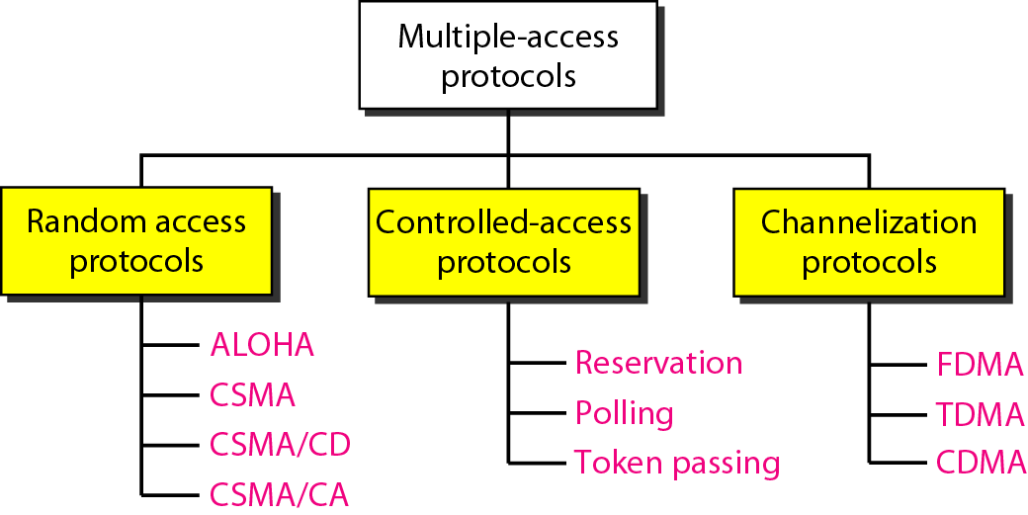
Taxonomy of multiple-access protocols

Slide 66
Multiple Access protocols
single shared broadcast channel
two or more simultaneous transmissions by nodes: interference
collision if node receives two or more signals at the same time
multiple access protocol
distributed algorithm that determines how nodes share channel, i.e., determine when node can transmit
communication about channel sharing must use channel itself!
no out-of-band channel for coordination

Slide 67
Ideal Multiple Access Protocol
Broadcast channel of rate R bps (assumptions)
1. when one node wants to transmit, it can send at rate R.
2. when M nodes want to transmit, each can send at average rate R/M
3. fully decentralized:
no special node to coordinate transmissions
no synchronization of clocks, slots
4. simple

Slide 68
MAC Protocols: a taxonomy
Channel Partitioning
divide channel into smaller “pieces” (time slots, frequency, code)
allocate piece to node for exclusive use
TDMA, FDMA, CDMA
“Taking turns”
Two methods: polling from central site or token passing
nodes take turns, but nodes with more to send can take longer turns
Bluetooth, FDDI, IBM Token Ring
Random Access (dynamic)
channel not divided, allow collisions
“recover” from collisions
ALOHA, S-ALOHA, CSMA
CSMA/CD used in Ethernet
CSMA/CA used in 802.11

Slide 69
Channel Partitioning MAC protocols: TDMA
TDMA: time division multiple access
access to channel in "rounds"
each station gets fixed length slot (length = pkt trans time) in each round
unused slots go idle
example: 6-station LAN, 1,3,4 have pkt, slots 2,5,6 idle
6-slot
frame
1
3
4
1
3
4

Slide 70
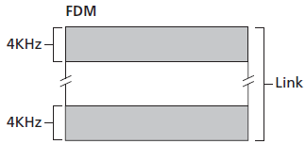
Channel Partitioning MAC protocols: FDMA
FDMA: Frequency division multiple access
FDM divides the R bps channel into different frequencies (each with a bandwidth of R/N) and assigns each frequency to one of the N nodes.

Slide 71
Channel Partitioning MAC protocols: CDMA
CDMA: Code division multiple access
CDMA assigns a different code to each node. Each node then uses its unique code to encode the data bits it sends.

Slide 72
Channel partitioning MAC protocols:
Limitations:
share channel efficiently and fairly at high load
inefficient at low load: delay in channel access, 1/N bandwidth allocated even if only 1 active node!

Slide 73
“Taking Turns” MAC protocols
Polling:
master node “invites” slave nodes to transmit in turn
typically used with “dumb” slave devices
concerns:
polling overhead
latency
single point of failure (master)
data
poll
master
data
slaves

Slide 74
“Taking Turns” MAC protocols
Token passing:
control token passed from one node to next sequentially.
token message
concerns:
token overhead
latency
single point of failure (token)
T
(nothing
to send)
T
data

Slide 75
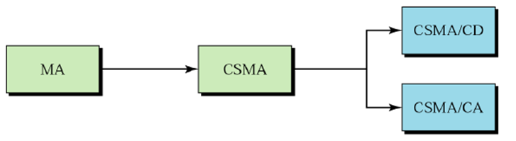
RANDOM ACCESS
In random access or contention methods, no station is superior to another station and none is assigned the control over another. At each instance, a station that has data to send uses a procedure defined by the protocol to make a decision on whether or not to send.
Topics :
ALOHA Carrier Sense Multiple Access
Carrier Sense Multiple Access with Collision Detection
Carrier Sense Multiple Access with Collision Avoidance

Slide 76
Random Access Protocols
When node has packet to send
transmit at full channel data rate R.
no a priori coordination among nodes
two or more transmitting nodes ➜ “collision”,
random access MAC protocol specifies:
how to detect collisions
how to recover from collisions (e.g., via delayed retransmissions)
Examples of random access MAC protocols:
slotted ALOHA
ALOHA
CSMA, CSMA/CD, CSMA/CA

Slide 77
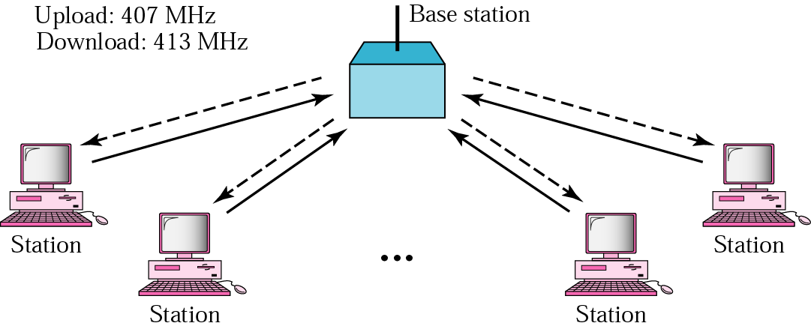
Random Access Protocols: ALOHA
In the 1970s, Norman Abramson and his colleagues at the University of Hawaii devised a new and elegant method to solve the channel allocation problem.
Systems in which multiple users share a common channel in a way that can lead to conflicts are widely known as contention systems

Slide 78
Pure ALOHA
The idea is that each station sends a frame whenever it has a frame to send.
When a station sends a frame, it expects the receiver to send an acknowledgment.
If the acknowledgment does not arrive after a time-out period, the station assumes that the frame (or the acknowledgment) has been destroyed and resends the frame.

Slide 79
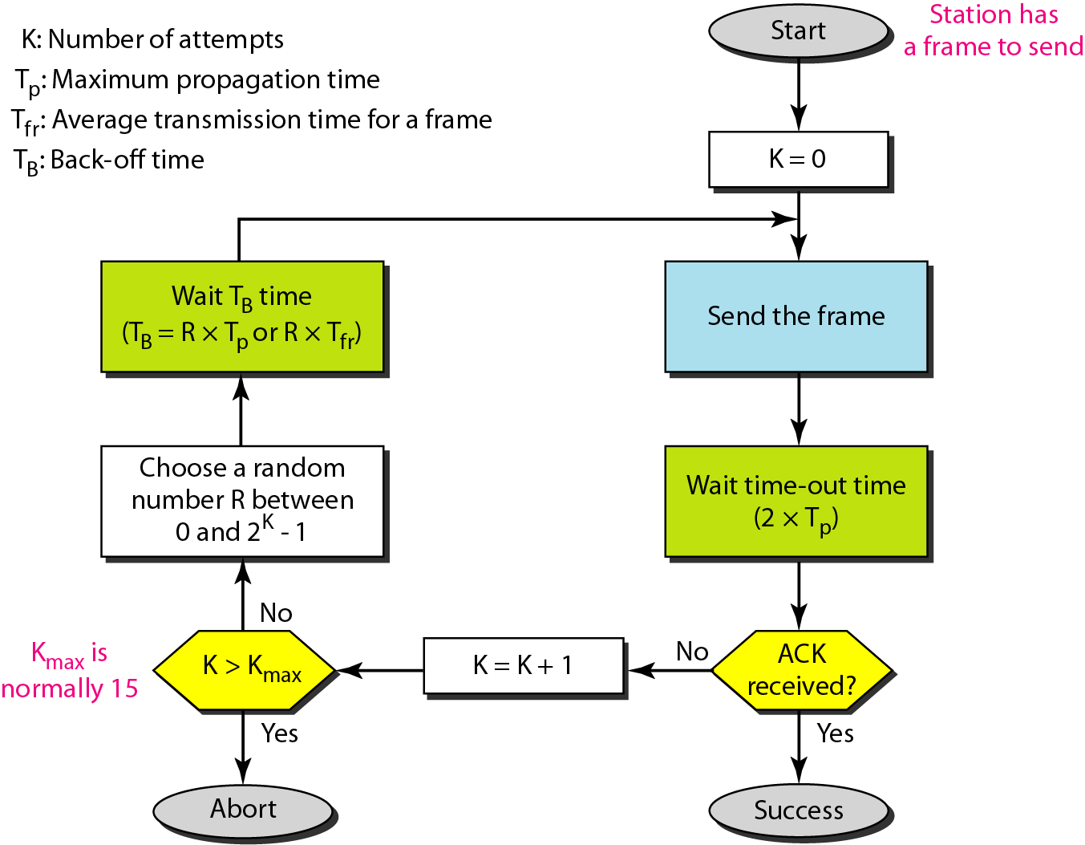
Procedure for pure ALOHA protocol

Slide 80
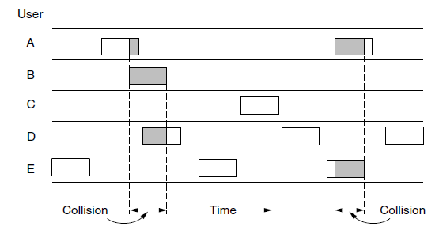
Pure ALOHA
In pure ALOHA, frames are transmitted at completely arbitrary times.

Slide 81
What is the efficiency of an ALOHA Channel?
Let us first consider an infinite collection of users typing at their terminals (stations). A user is always in one of two states: typing or waiting.
Initially, all users are in the typing state. When a line is finished, the user stops typing, station of user transmits the frame over a shsred channel, waiting for a response.
If successful, the user sees the reply and goes back to typing.
If not, the user continues to wait while the station retransmits the frame over and over until it has been successfully sent.

Slide 82
What is the efficiency/throughput of an ALOHA channel?
Assumptions:
''frame time'‘ denotes the amount of time needed to transmit the standard, fixed-length frame
Infinite population of users generates new frames according to a
Poisson distribution with
N= mean number of frames per frame time.
For reasonable throughput we would expect 0 < N < 1.

Slide 83
Efficiency/throughput of pure ALOHA
Assume that the probability of k transmission attempts per frame time, old and new combined, is also Poisson, with mean G per frame time
At all load, throughput, S, is just the offered load, G, times the probability, P₀, of a
Transmission succeeding—that is, S = GP₀,
P₀ =is the probability that a frame does not suffer a collision.

Slide 84

Efficiency/throughput of pure ALOHA
A frame will not suffer a collision if no other frames are sent within one frame time of its start. Let t be the time required to send a frame. If any other user has generated a frame between time t₀ and t₀ + t, the end of that frame will collide with the beginning of the shaded one.
In pure ALOHA a station does not listen to the channel before transmitting. Any other frame started between t₀ + t and t₀ + 2t will bump into the end of the shaded frame.
The probability that k frames are generated during a given frame time is given by the Poisson distribution:

Slide 85
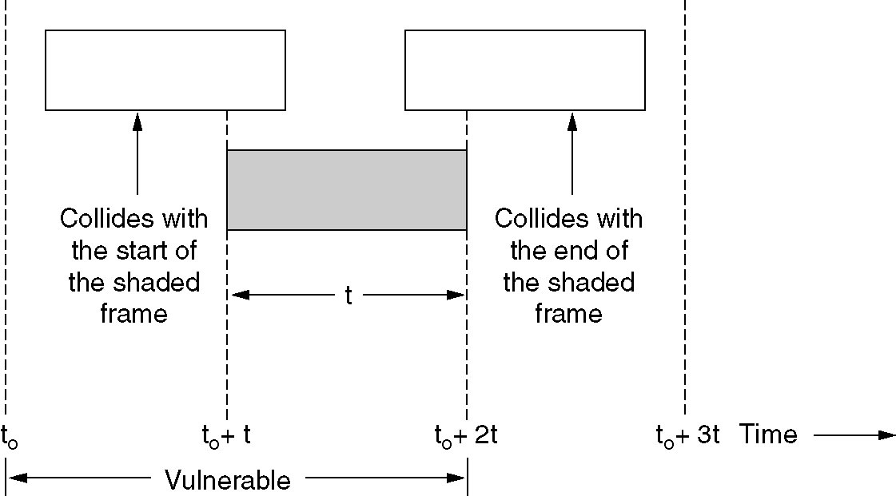
Pure ALOHA
Frame under consideration
Start
Vulnerable period for the shaded frame.

Slide 86
Efficiency/throughput of pure ALOHA
So the probability of zero frames is just e^{-G}
In an interval two frame times long, the mean number of frames generated is 2G
The probability of no other traffic being initiated during the entire vulnerable period is thus given by P₀ = e ^{-2G}. Using S = GP₀, we get
S = Ge^{−2G}
maximum throughput occurs at G = 0.5, with S = 1/2e, which is about 0.184.

Slide 87
Efficiency/throughput of pure ALOHA
Assumptions:
all frames same size
time divided into equal size slots (time to transmit 1 frame)
nodes start to transmit only slot beginning
nodes are synchronized
if 2 or more nodes transmit in slot, all nodes detect collision
Operation:
when node obtains fresh frame, transmits in next slot
if no collision: node can send new frame in next slot
if collision: node retransmits frame in each subsequent slot with prob. p until success

Slide 88
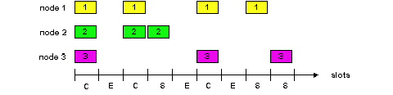
Slotted ALOHA
Pros
single active node can continuously transmit at full rate of channel
highly decentralized: only slots in nodes need to be in sync
simple
Cons
collisions, wasting slots
idle slots
nodes may be able to detect collision in less than time to transmit packet
clock synchronization

Slide 89
Slotted Aloha efficiency/throughput
In Roberts’ method, which has come to be known as slotted ALOHA—in contrast to Abramson’s pure ALOHA—a station is not permitted to send whenever the user types a line.
The probability of no other traffic during the same slot as our test frame is then e ^{−G}, which leads to
S = Ge^{−G}
As we can see from figure slotted ALOHA peaks at G = 1, with a throughput of
S = 1/e
or about 0.368, twice that of pure ALOHA.

Slide 90
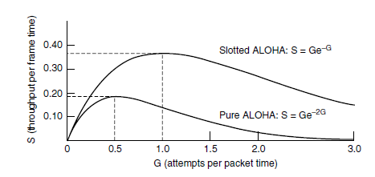
Throughput versus offered traffic for ALOHA systems.

Slide 91
Calculating Throughput: Alternative Method
Let’s modify the protocol a little and assume that each node attempts to transmit a frame in each slot with probability p.
Suppose there are N nodes. Then the probability that a given slot is a successful slot is the probability that one of the nodes transmits and that the remaining N – 1 nodes do not transmit
The probability that a given node transmits is p; the probability that the remaining nodes do not transmit is (1 – p)^{N-1}. Therefore the probability a given node has a success is p(1 – p)^{N-1}.
Because there are N nodes, the probability that any one of the N nodes has a success is Np(1 – p)^{N-1}.

Slide 92
Question 1
The efficiency of ALOHA
When there are N active nodes the efficiency of slotted ALOHA is Np(1-p)^{N-1}, find the value p that maximizes the expression
Using the value of p found in (a), find the efficiency of slotted ALOHA by letting N approach infinity.

Slide 93
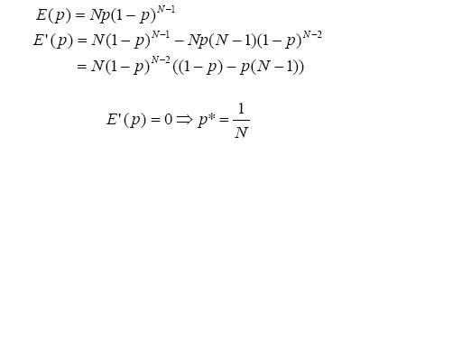
solution

Slide 94
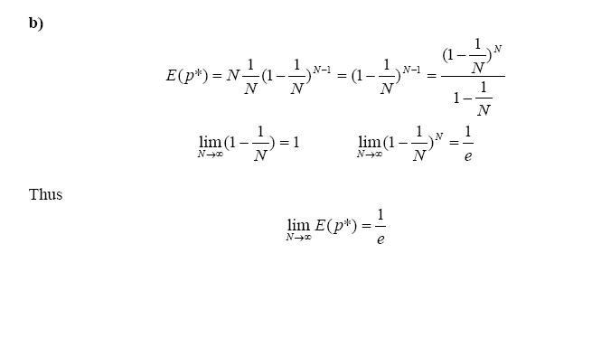

Slide 95
Maximum efficiency of pure ALOHA
Show that the maximum efficiency of pure ALOHA is 1/(2e)

Slide 96
CSMA (Carrier Sense Multiple Access)
Carrier sense multiple access (CSMA) requires that each station first listen to the medium (or check the state of the medium) before sending.
In other words, CSMA is based on the principle "sense before transmit" or "listen before talk."

Slide 97
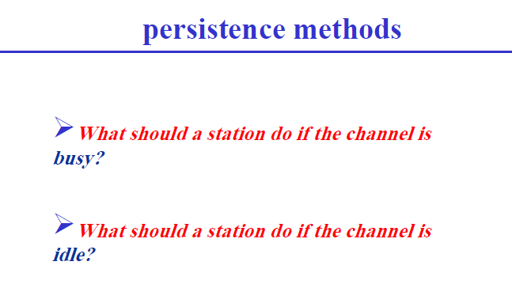

Slide 98
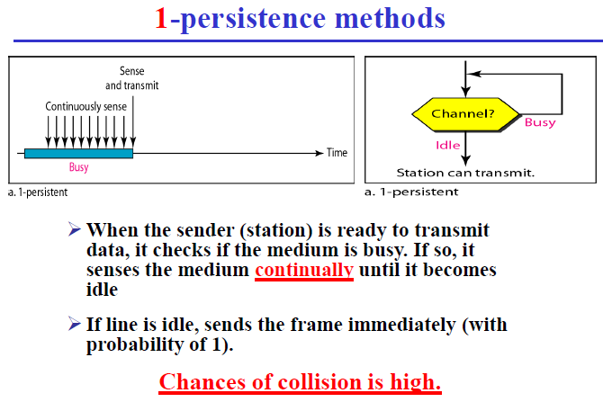

Slide 99
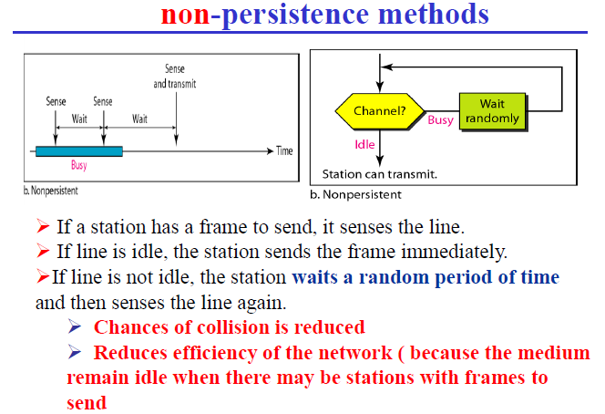

Slide 100
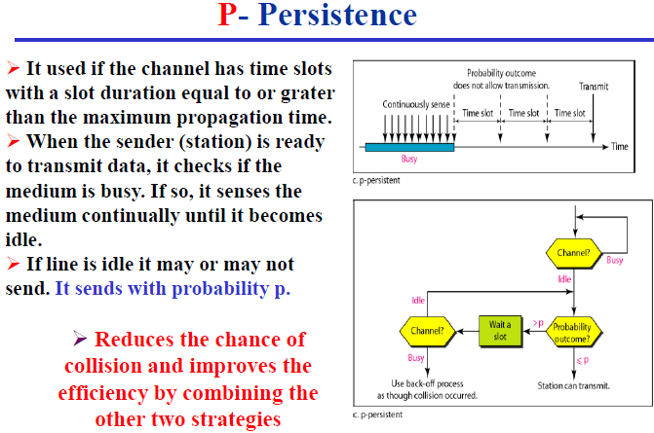

Slide 101
Backoff
Problem
What should be done when collision happens?
Solution
Backoff for a random period of time
Backoff Operation
When transmitting a packet, choose a backoff interval in the range [0,cw]
cw is max backoff time
Count down the backoff interval when medium is idle
Count-down is suspended if medium becomes busy
When backoff interval reaches 0, transmit the packet

Slide 102
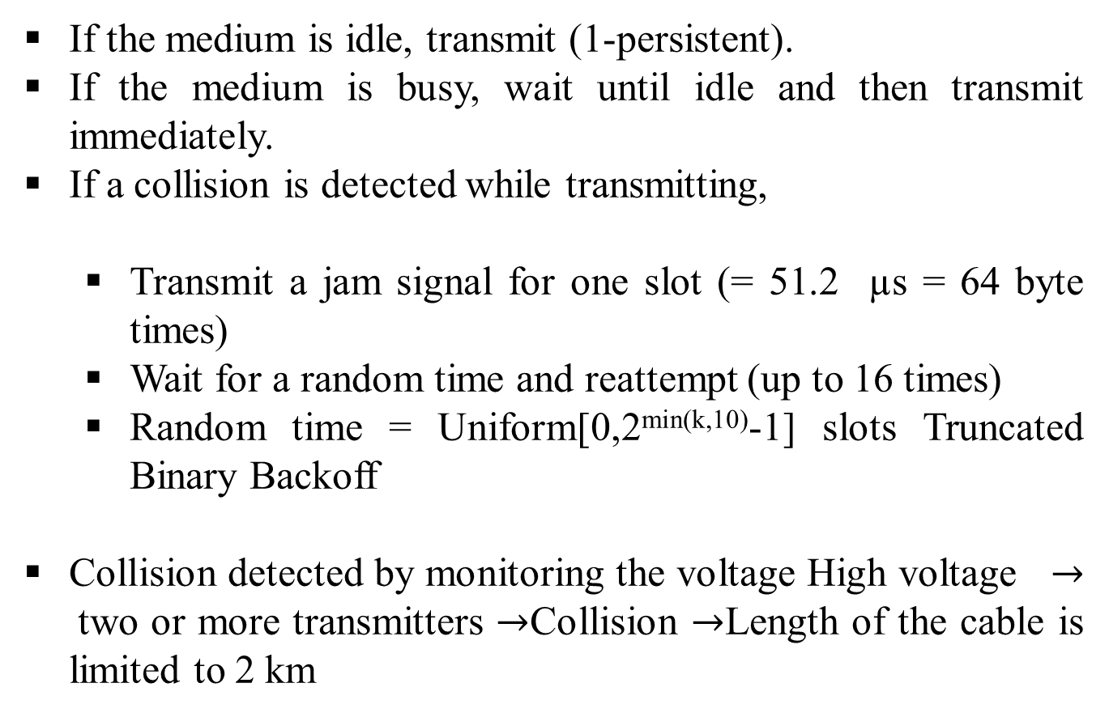
IEEE 802.3 CSMA/CD
If the medium is idle, transmit (1-persistent).
If the medium is busy, wait until idle and then transmit immediately.
If a collision is detected while transmitting,
Transmit a jam signal for one slot (= 51.2 µs = 64 byte times)
Wait for a random time and reattempt (up to 16 times)
Random time = Uniform[0,2^{min(k,10)}-1] slots Truncated Binary Backoff
Collision detected by monitoring the voltage High voltage $→$two or more transmitters $→$Collision $→$Length of the cable is limited to 2 km

Slide 103
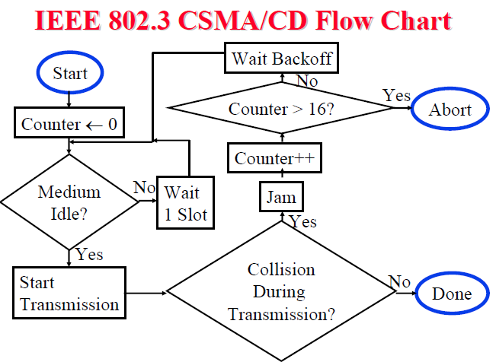

Slide 104
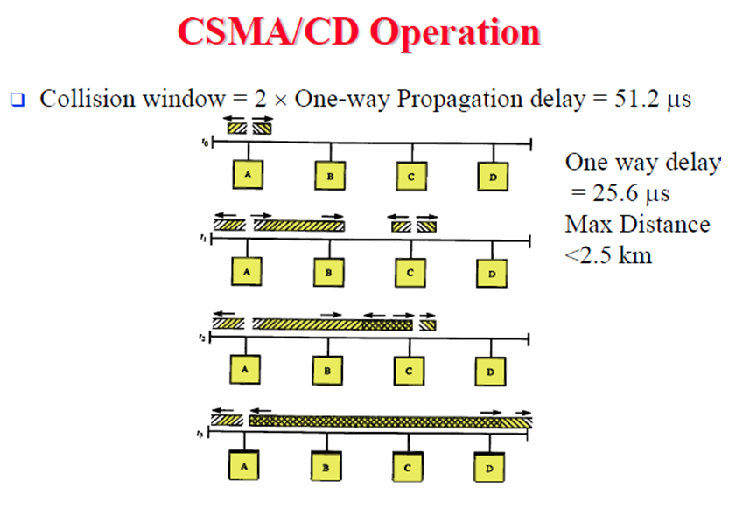

Slide 105
CSMA/CA
We need to avoid collisions on wireless networks because they cannot be detected. Carrier sense multiple access with collision avoidance (CSMA/CA) was invented for this network. Collisions are avoided through the use of CSMA/CA's three strategies: the interframe space, the contention window, and acknowledgments.
Interframe Space (IFS): If after the IFS time the channel is still idle, the station can send, but it still needs to wait a time equal to the contention time. In CSMA/CA, the IFS can also be used to define
the priority of a station or a frame.

Slide 106
CSMA/CA
Contention Window: The contention window is an amount of time divided into slots. A station that is ready to send chooses a random number of slots as its wait time. The number of slots in the window changes according to the binary exponential back-off strategy.
Acknowledgment: With all these precautions, there still may be a collision resulting in destroyed data. The positive acknowledgment and the time-out timer can help guarantee that the receiver has received the frame.

Slide 107
CSMA/CA
Procedure: the channel needs to be sensed before and after the IFS. The channel also needs to be sensed during the contention time. For each time slot of the contention window, the channel is sensed. If it is found idle, the timer continues; if the channel is found busy, the timer is stopped and continues after when the channel is sensed as idle.

Slide 108
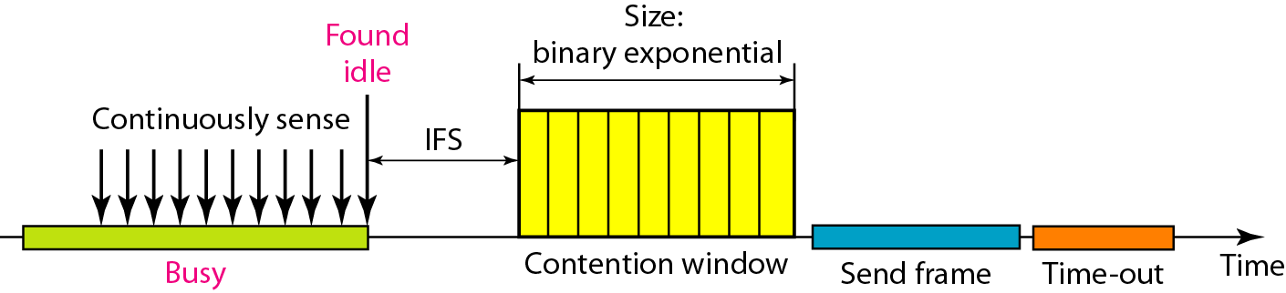
Figure Timing in CSMA/CA

Slide 109
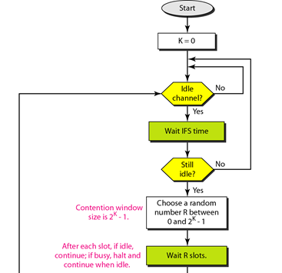
Figure Flow diagram for CSMA/CA

Slide 110

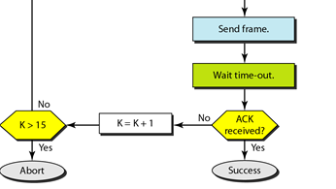

Slide 111
Contention Window Adaptation
Observation
The time spent counting down backoff intervals is a part of MAC overhead
Choosing a large cw leads to large backoff intervals, thus underutilizing the channel
Choosing a small cw leads to a larger number of collisions (when two nodes count down to 0 simultaneously)
CW should be chosen adaptively based on the degree of contention in the network.
The degree of contention depends on the number of hosts attempting to transmit in the network.
Estimated via collision occurrences.

Slide 112
Moving towards Wireless Network
Can CSMA/CD be used in wireless network?
NO
Why?
Collision detection requires the ability to send and receive at the same time. Because the strength of the received signal is typically very small compared to the strength of the transmitted signal in wireless networks. It is costly to build hardware that can detect a collision.
Hidden terminal problem.

Slide 113
Hidden Terminal Problem
Node B can communicate with A and C both.
A and C cannot hear each other.
When A transmits to B, C cannot detect the transmission using the carrier sense mechanism.
If C transmits, collision will occur at node B.
Collision
A
B
C

Slide 114
CSMA/CA -- Carrier Sense Multiple Access with Collision Avoidance
Collision Avoidance
Inform other nodes of an intent to transmit
When the other nodes have been notified, the information is transmitted.
Prevents collision because all nodes are aware of a transmission before it occurs.
CSMA/CA is particularly useful in wireless networks, where reliable collision detection is not possible.
IEEE 802.11 implements CSMA/CA using short
Request-to-Send and Clear-to-Send messages.

Slide 115
Solution for Hidden Terminal Problem
When node A wants to send a packet to node B, node A first sends a Request-to-Send (RTS) to B.
On receiving RTS, node B responds by sending Clear-to-Send (CTS) .
When a node (such as C) overhears a CTS, it keeps quiet for the duration of the transfer.
Transfer duration is included in RTS and CTS both
RTS
A
B
C
CTS
DATA

Slide 116
Carrier Sense in IEEE 802.11 DCF
Collision avoidance
Nodes stay silent when carrier sensed (both physical and virtual)
Physical carrier sense -- required
Virtual carrier sense -- optional
Use RTS/CTS & Network Allocation Vector (NAV)
NAV is updated based on overheard RTS/CTS/DATA/ACK packets, each of which specified duration of a pending transmission
Optional based on data packet size

Slide 117
IEEE 802.11
The area reserved by virtual carrier sensing
Reserved area
DATA
A
B
C
D
E
F
ACK

Slide 118
IEEE 802.11
The area reserved by virtual + physical carrier sensing
Carrier sensing range = interference range
Carrier sense
range
DATA
A
A
B
C
D
E
F
F
Transmit range

